Slide 1


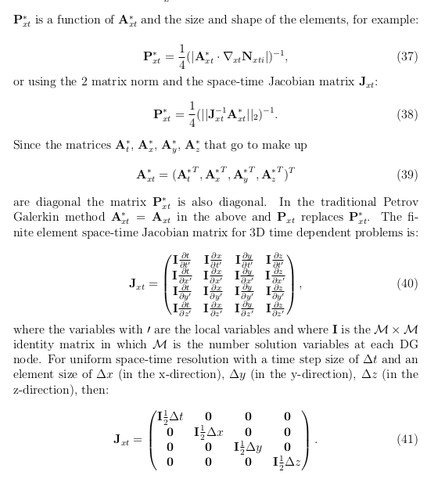
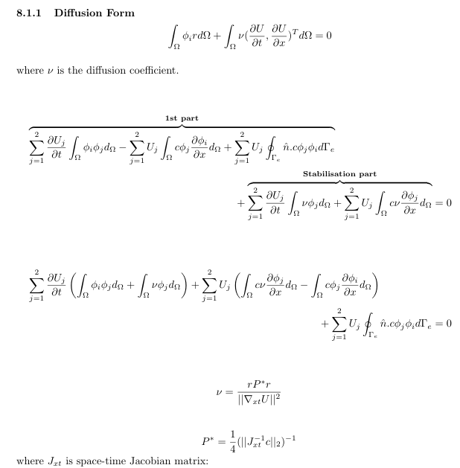

Amin Nadimy
- 1D-DG Petrov-Galerkin FEM: 2 documents
1- Report
1- Theory
ICL-ICAM-BP Q1 Meeting
24th March 2021

Slide 2
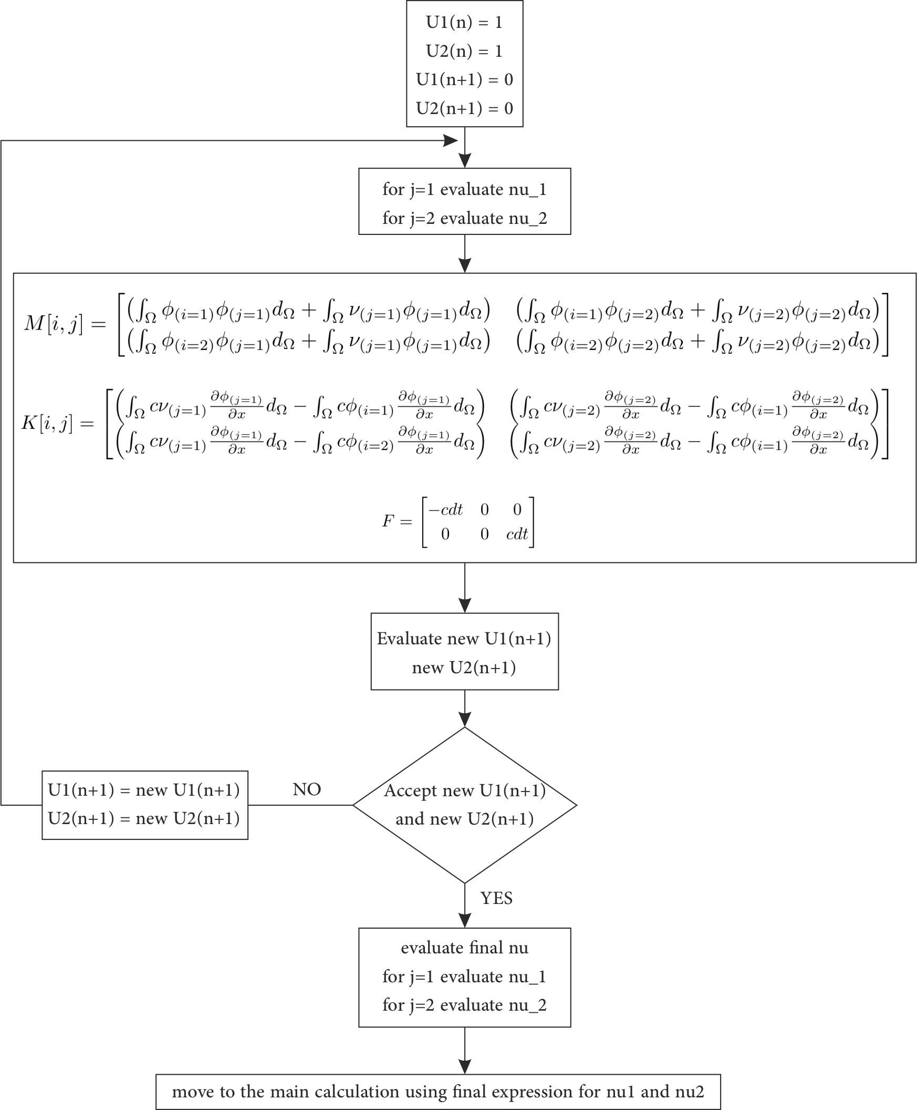
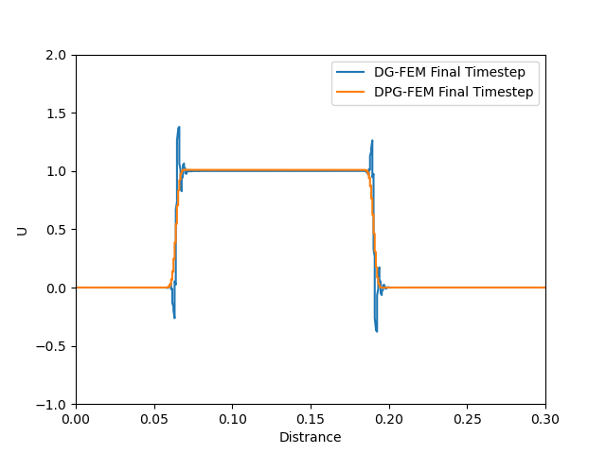
Illustration of the standard DG against DPG results for the same number of elements.
Flowchart for the DG Petrov-Galerkin diffusion method.
ICL-ICAM-BP Q1 Meeting
24th March 2021

Slide 3
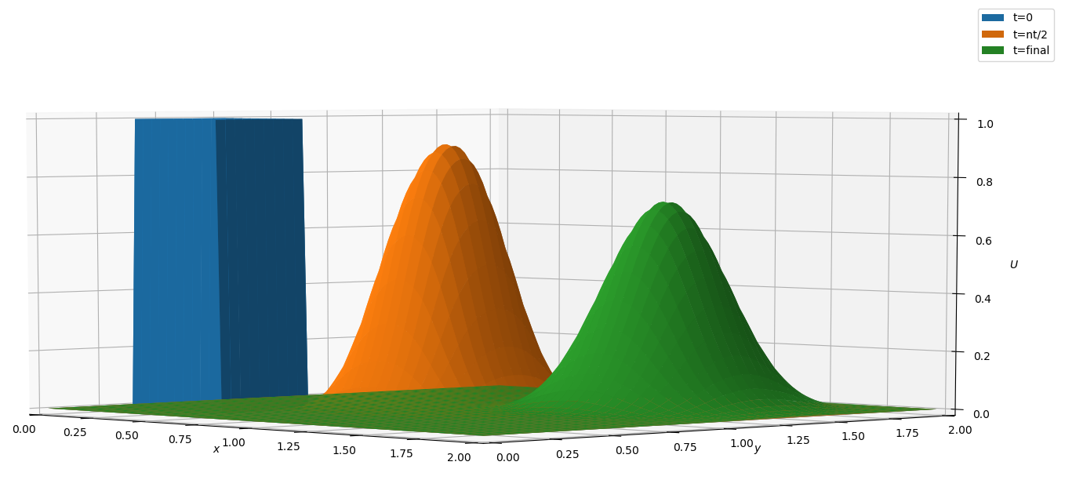
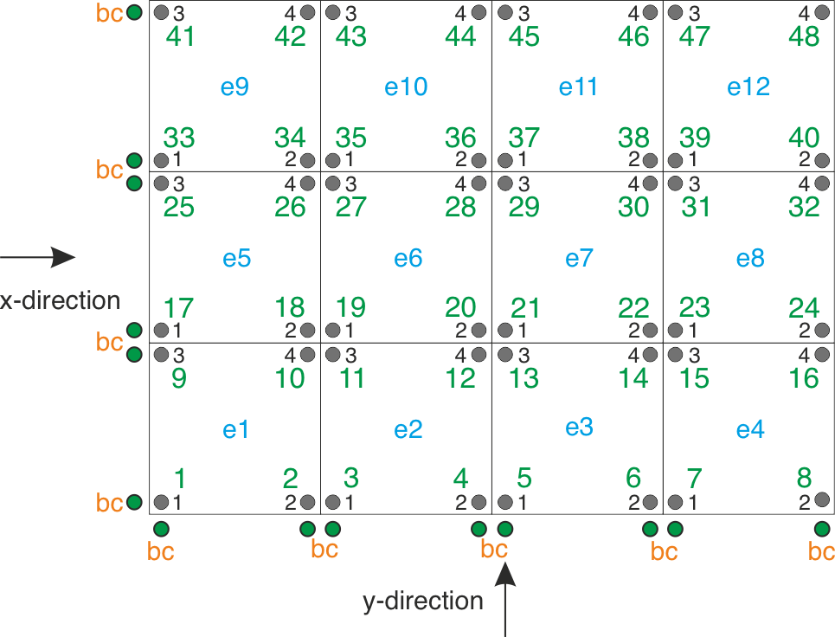
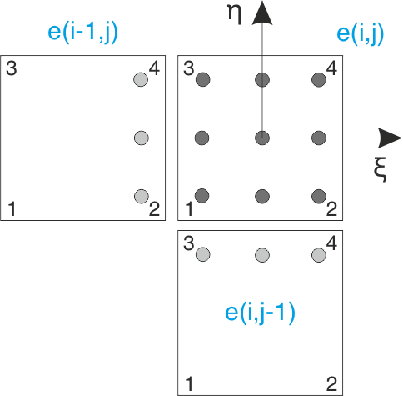
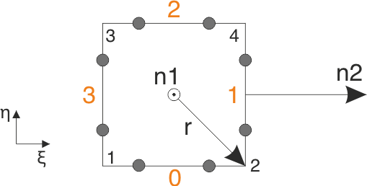
- 2D FDM
- 2D FDM
Surface integral using 2 points Gaussian quadrature method
Volume integral using 3 points Gaussian quadrature method
2D domain with local & global node numbering
ICL-ICAM-BP Q1 Meeting
24th March 2021

Slide 4
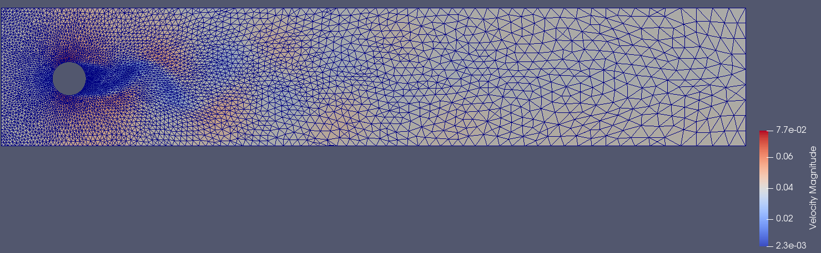
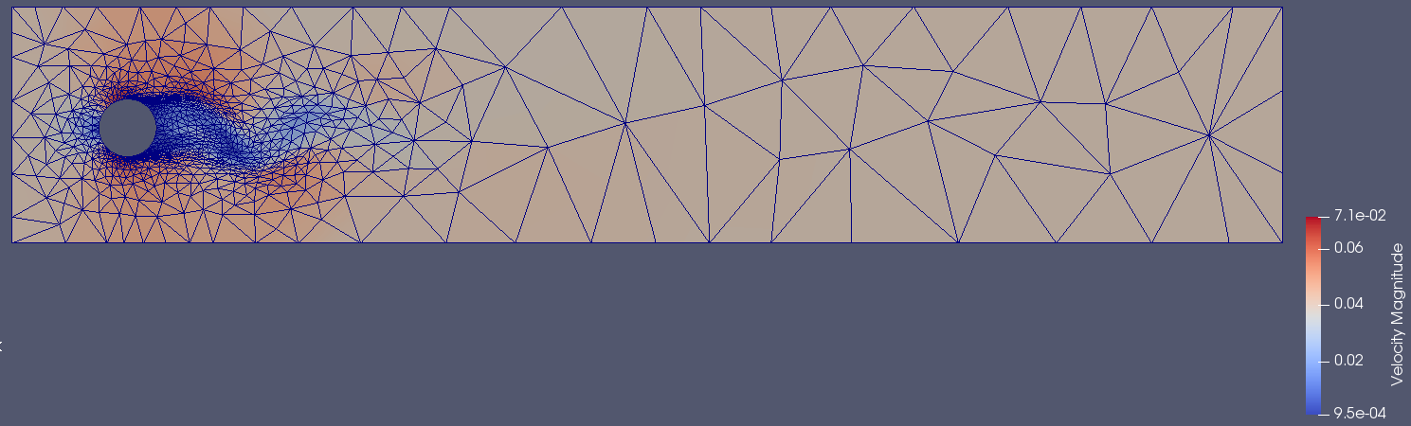
- Fortran Training - IC-FERST Workshop
Training sessions: multi-phase time-loop in the IC-FERST, identified the key subroutines corresponding to momentum, magma, porous media equations and their variables.
Training for connecting & working with workstations, downloading and compiling IC-FERST code.
ran 2D test files e.g. flow pass in a cylinder & collapsing water column. changed the flow velocity, the shapes and the positions of the problem.
Flow pass a cylinder with a 2D fixed mesh
Flow pass a cylinder with a 2D adaptive mesh
ICL-ICAM-BP Q1 Meeting
24th March 2021

Slide 5
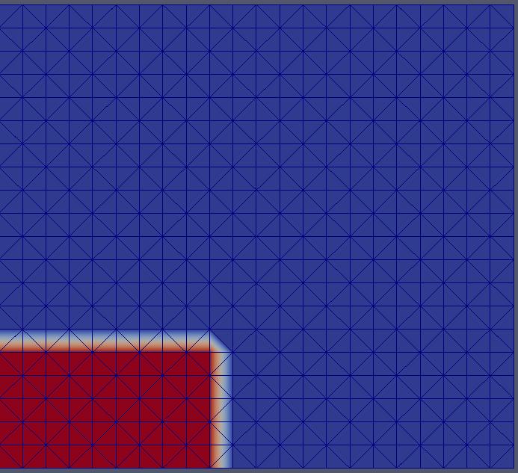
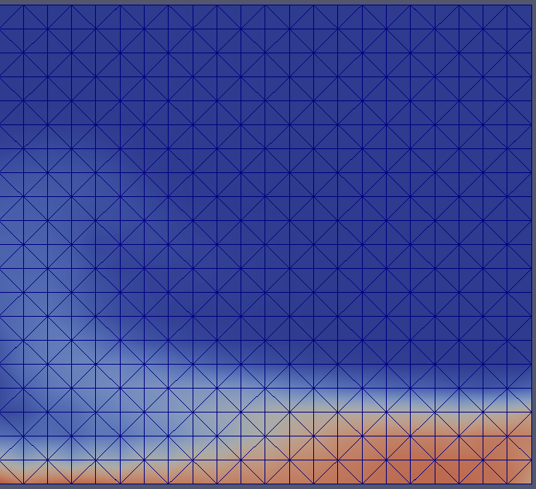
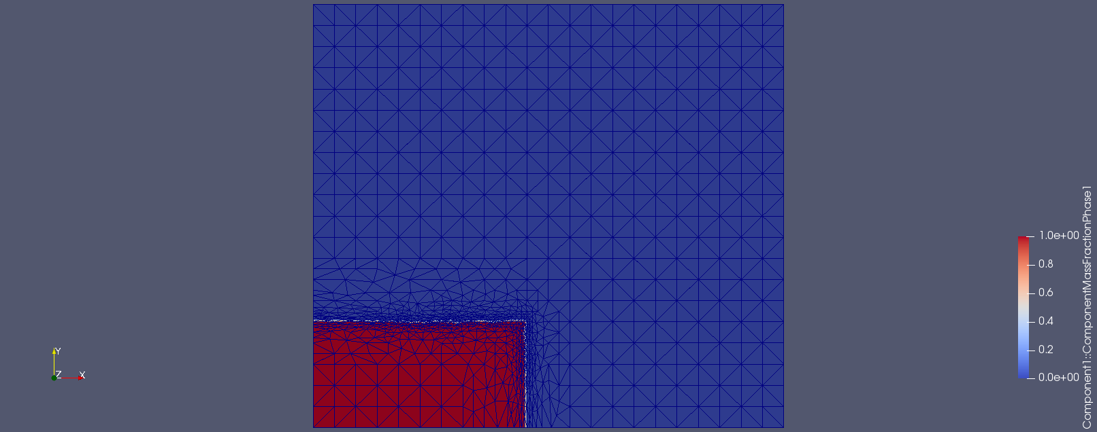
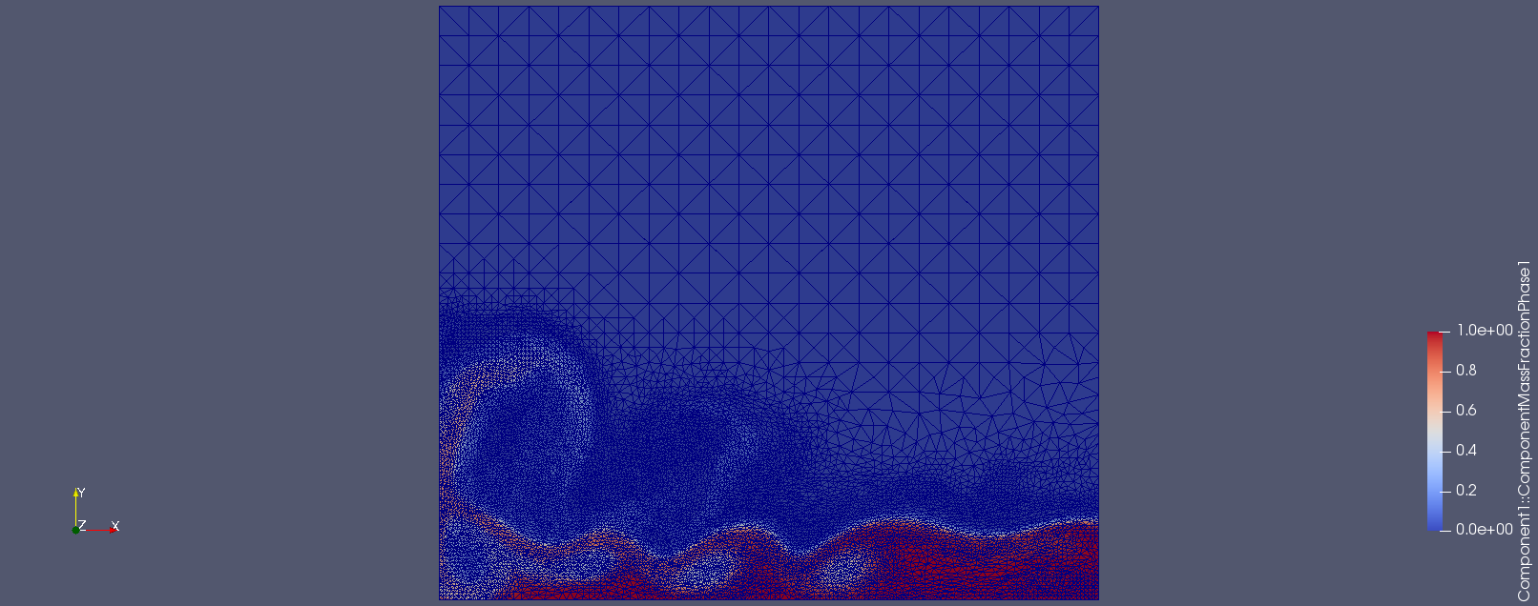
- Fortran Training - IC-FERST training
Training sessions: multi-phase time-loop in the IC-FERST, identified the key subroutines corresponding to momentum, magma, porous media equations and their variables.
Training for connecting & working with workstations, downloading and compiling IC-FERST code.
ran 2D test files e.g. flow pass in a cylinder & collapsing water column. changed the flow velocity, the shapes and the positions of the problem.
Collapsing water column under gravity with a fixed mesh
Collapsing water column under gravity with an adaptive mesh
ICL-ICAM-BP Q1 Meeting
24th March 2021

Slide 6
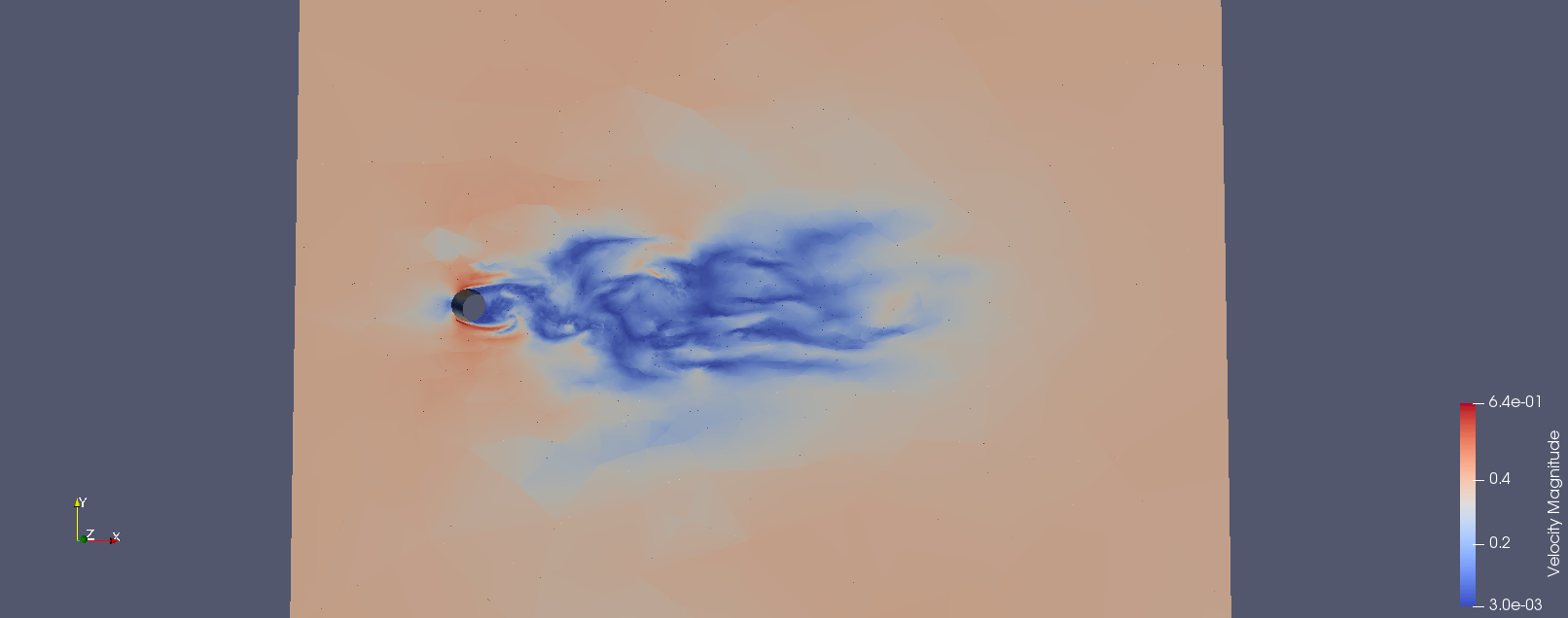
ran a 3D test files for flow pass in a cylinder case .
Flow pass a cylinder with a 3D adaptive mesh
ICL-ICAM-BP Q1 Meeting
24th March 2021

Slide 7
Regular weekly meetings
AMCG catch-up
Porous media/Inertia
BP catch-up
Theory
Delaunay and barycenter triangulation
Voronoi diagram
Structured mesh generation
Unstructured mesh generation
Semi-structured mesh
Near-future work
Will be working with Dr. Obeysekara on the flow in a tank problem
2D 1st order square wave DG-FEM
semi-structured 2D DG-FEM.
Will be work with Prof. Pain and others on the Fortan code for semi-structured and with space-time within ICFERST/FLUIDITY.
ICL-ICAM-BP Q1 Meeting
24th March 2021

Slide 8
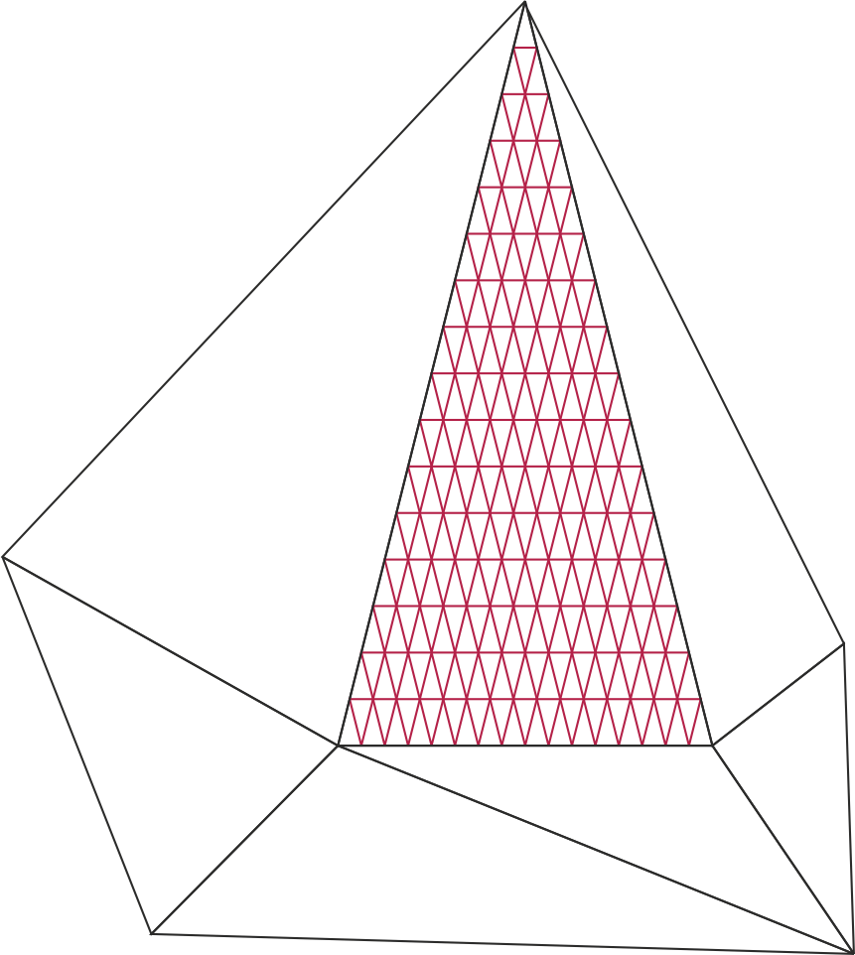
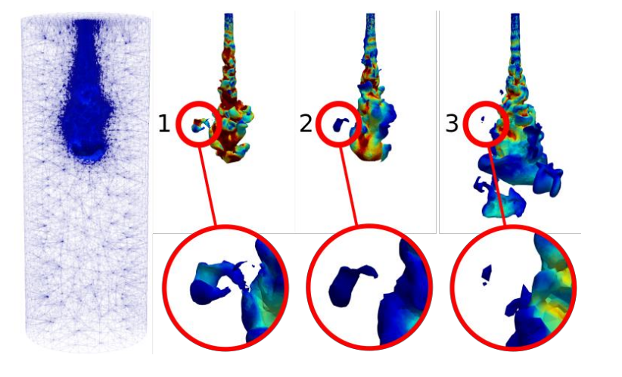

PhD project
Dynamic semi-structured meshes for fast numerical simulation of Multi-Phase Modelling in the energy industry
Figure 2. Creation and dispersion of a droplet
Figure 1. Semi-structured mesh
Applied Modelling and Computational Group, Department of Earth Science and Engineering
Supervisors:
Professor C. C. Pain, Dr P. Salinas, Dr A. I. Obeysekara and Dr A. Nicolle (BP)
ICL-ICAM-BP Q1 Meeting
24th March 2021

